Slide 1
Object oriented programming
Iván Guerrero Román

Slide 2
Session #17
Today’s topics
4. Inheritance and polymorphism
a. Concept of inheritance
b. Access modifiers
c. Concept of polymorphism
d. Overriding and overloading
e. Abstract classes and interfaces

Slide 3
Principles of OOP
Encapsulation
Hide unnecessary details in our classes and provide a clear and simple interface for working with them
Abstraction
Only consider the important characteristics of a class without worrying on the details
Inheritance
Improve code readability and enable reuse of code
Polymorphism
Work in the same manner with different types of objects

Slide 4
Cohesion
It shows to what degree program’s tasks and responsibilities are related to one another, i.e. how much a program is focused on solving a single problem.
Strong cohesion
It indicates that the responsibilities and tasks of a piece of code (a method, class, component or a program) are related to one another and intended to solve a common problem.
Strong cohesion is a typical characteristic of high-quality software.
Weak cohesion
It is observed along with methods, which perform several unrelated tasks.

Slide 5
Coupling
It describes the extent to which components / classes depend on one another.
Loose coupling
It is defined by a piece of code’s communication with other code through clearly defined interfaces.
A change in the implementation of a loosely coupled component doesn’t reflect on the others it communicates with
Tight coupling
Tight coupling between two or more methods, classes or components means that they cannot work independently of one another and that a change in one of them will also affect the rest.

Slide 6
Exercise
The SAT asks you for an application to generate RFCs of physical and moral persons, and the CURP of physical persons
To generate the RFC of an individual, you use the following information:
First two letters of the paternal surname
First letter of the maternal surname
First letter of the first name
Last two digits of the year of birth
Two digits of the month of birth
Two digits of the day of birth
To generate the RFC of a moral person, you use the following information
First letter of each of the first 3 words of its social denomination
Last two digits of the year of registration
Two digits of the month of registration
Two digits of registration day

Slide 7
To generate the CURP of a physical person you use the following information:
RFC (without verification code)
Gender (H for male, M for female)
Two-letter code to identify the state of birth
Next consonant of the paternal surname
Following two consonants of the maternal surname
A check value consisting of two random digits

Slide 8
Write the Java code for each of the following elements:
IRegistry interface
IKey interface
Person class. Consider that it is an abstract class.
MoralPerson class. Implement the method to obtain a RFC
PhysicalPerson class. Implement the methods to obtain the RFC and the CURP codes.
A demo class where you create object from every possible class, and obtain their RFC and CURP codes.

Slide 9
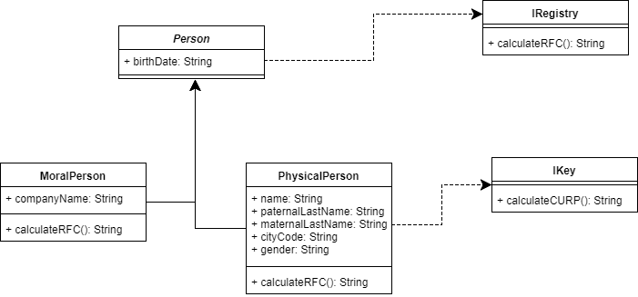

Slide 10
Information sources
https://introprogramming.info/english-intro-csharp-book/read-online/chapter-20-object-oriented-programming-principles/#_Toc362296570

Slide 11
Session #17
Today’s topics
4. Inheritance and polymorphism
a. Concept of inheritance
b. Access modifiers
c. Concept of polymorphism
d. Overriding and overloading
e. Abstract classes and interfaces

